Slide 1
WHAT WILL I LEARN TODAY?
What is quote integration?
Why is this really, really important????
You have to use direct quotes in your Animal Farm final paper!

Slide 2
QUOTE INTEGRATION
When you write your Animal Farm paper, you need to use direct word-for-word evidence from your book.
When you take some out of the text and include it in your own writing, you are “quoting” it.
When you use a quote, you have to do quote integration so that the quote flows and is cited properly—if not, it is plagiarism and creates weak writing.

Slide 3
WHAT READS BETTER??
***Highlight the direct quotes!
When you think about dystopia, the short story Harrison Bergeron is a perfect example because the government gave people “a little mental handicap” (Vonnegut, 1) to make everyone equal. But, the true results are scary…
When you think about dystopia, the short story Harrison Bergeron is a perfect example because the government gave people handicaps. “George, while his intelligence was way above normal, had a little mental handicap radio in his ear” (Vonnegut, 1). This made everyone equal. But, the true results are scary…

Slide 4
QUOTE INTEGRATION
You don’t want HOVERING Quotes.
Instead you want to mix YOUR words and the TEXT’S words.
It is very bad when the quote “hovers” and has no grounding in a body paragraph. It disrupts the flow of your ideas.

Slide 5
QUOTE INTEGRATION
Text’s Words
My Words!
The book says, “the things they carried were largely determined by necessity” (O’Brien, 2).
So use one of the following: DAB, DOLLOP, or LOTSA SAUCE.
This will help fix those hovering quotes!

Slide 6
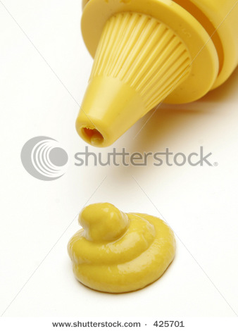
QUOTE INTEGRATION
My Words!
Text’s Words
Squealer states, “the windmill was, in fact, Napoleon’s own creation” (Orwell, 71).
This is a DAB because…
It is only a little bit of my words, and lots of words from the text.

Slide 7
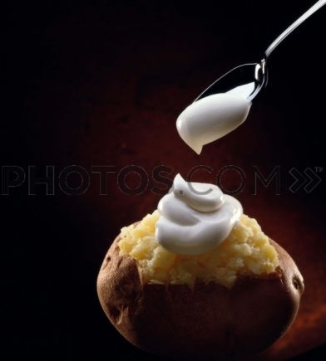
QUOTE INTEGRATION
My Words!
The Current Health Teens editorial mentions, “we need a tanning version of the successful anti-tobacco efforts!” (“Mixed Messages”).
This is a DOLLOP because…
It is more of my words and should read half and half.
Text’s Words

Slide 8
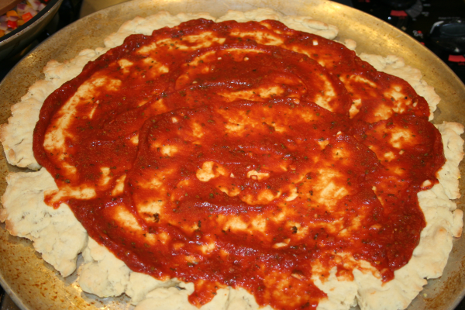
QUOTE INTEGRATION
My Words!
It is easy to see that Squealer is not to be trusted because whenever he talks he always looks “very sly” (Orwell, 71).
This is LOTSA SAUCE because…
It is a lot of my words, with a very short quote from the text. This is the most stylish!
Text’s Words

Slide 9
Remember CITATION set-up
Use quotation marks.
Remember it should look like the following:
“This is a quote” (Orwell, 10).
Page Number!
Author’s Last name OR Article Title
End Quotation Marks
Period

Slide 10
DOUBLE PUNCUTATION
Use quotation marks.
Remember it should look like the following:
“This is a quote?” (Orwell, 10).
Page Number!
! Or ? Mark
End Quotation Marks
Still a Period

Slide 11
CITATION
Citation will be:
Author’s Last Name or Article Title (shorten if needed), and a page number if available.
Use MLA citation—this will be on the research paper!

Slide 12
YOUR TURN
Use the space on your packet to create a sentence of your own using a quote from Animal Farm…
Research show tanning and cigarettes ads have “striking similarities” (“Mixed Messages”).
LOTSA SAUCE!

Slide 13
WRITE UP
Prompts
What are the key allegories Orwell uses and why?
What propaganda does Squealer use and why?
Who is responsible for Napoleon’s rule and control? Why?
Grading Tips:
1. Use at least two quotes, but for an “A” use more evidence or try evidence from one of our mentor texts.

Slide 14
CLOSING
One thing I have learned is…

