Slide 1
Agenda
*To This Day
*Literary Devices Vocab and Definitions
*Revisit To This Day
*Edit your own essay to include more literary devices
*Closing: I learned.

Slide 2
MATERIALS
**To This Day Packet
**Literary Devices Chart
**Literary Devices Term Posters

Slide 3
What will I learn today?
FOCUS: How can I revise my writing with literary devices?

Slide 4
VIDEO
Let’s watch a video that is a mentor text/poem…
http://www.youtube.com/watch?v=ltun92DfnPY
What did you notice? Shares…

Slide 5
LITERARY DEVICES
Go around the room and get a definition of the thirteen terms from the posters.
Simile, Metaphor, Onomatopoeia, Hyperbole, Alliteration, Personification, Irony, Imagery, Foreshadowing, Juxtaposition, Repetition, and Symbolism.
JUST GET THE DEFINITIONS for THE MOMENT!

Slide 6
TERM REVIEW
Add an example or two as we discuss!
Simile
Metaphor
Onomatopoeia
Hyperbole
Alliteration
Personification
Irony
Imagery
Foreshadow
Juxtaposition
Repetition
Characterization
Symbolism

Slide 7
TERM REVIEW
Comparing like or as:
I am crazy like a fox.
Simple, straight forward.
Simile
Metaphor
Onomatopoeia
Hyperbole
Alliteration
Personification
Irony
Imagery
Foreshadow
Juxtaposition
Repetition
Characterization
Symbolism

Slide 8
TERM REVIEW
Comparing WITHOUT using like or as:
My Mom is a rock.
More developed and intense.
Simile
Metaphor
Onomatopoeia
Hyperbole
Alliteration
Personification
Irony
Imagery
Foreshadow
Juxtaposition
Repetition
Characterization
Symbolism

Slide 9
TERM REVIEW
“Sound Words”
Boom! Crash. Crackle.
Sound and impact.
Simile
Metaphor
Onomatopoeia
Hyperbole
Alliteration
Personification
Irony
Imagery
Foreshadow
Juxtaposition
Repetition
Characterization
Symbolism

Slide 10
TERM REVIEW
A dramatic, exaggerated statement
This class takes forever!
Used A LOT with teens.
Simile
Metaphor
Onomatopoeia
Hyperbole
Alliteration
Personification
Irony
Imagery
Foreshadow
Juxtaposition
Repetition
Characterization
Symbolism

Slide 11
TERM REVIEW
Repeating same letter, sound in a series of words.
She sells sea shells by the seashore!
Used a lot with business, catchy!
Simile
Metaphor
Onomatopoeia
Hyperbole
Alliteration
Personification
Irony
Imagery
Foreshadow
Juxtaposition
Repetition
Characterization
Symbolism

Slide 12
TERM REVIEW
Giving something NOT human, human traits and qualities.
My dog smiled at me when I got home.
It can also include non-living things, like rain…
Simile
Metaphor
Onomatopoeia
Hyperbole
Alliteration
Personification
Irony
Imagery
Foreshadow
Juxtaposition
Repetition
Characterization
Symbolism

Slide 13
TERM REVIEW
Simile
Metaphor
Onomatopoeia
Hyperbole
Alliteration
Personification
Irony
Imagery
Foreshadow
Juxtaposition
Repetition
Characterization
Symbolism
Something turning out, not like you expected, twisted.
A fire truck on fire.
Remember the song.

Slide 14
TERM REVIEW
Create the image and using the five senses.
The sun was warm on my skin. It was a hazy yellow and changed as the sun set to a beautiful orange and pink.
Snapshots.
Simile
Metaphor
Onomatopoeia
Hyperbole
Alliteration
Personification
Irony
Imagery
Foreshadow
Juxtaposition
Repetition
Characterization
Symbolism

Slide 15
TERM REVIEW
Hints at what is to come: good and bad.
The boy sees a black cat and then gets hit by a truck.
Superstition sometimes, ever seen Final Destination?
Simile
Metaphor
Onomatopoeia
Hyperbole
Alliteration
Personification
Irony
Imagery
Foreshadow
Juxtaposition
Repetition
Characterization
Symbolism

Slide 16
TERM REVIEW
Simile
Metaphor
Onomatopoeia
Hyperbole
Alliteration
Personification
Irony
Imagery
Foreshadow
Juxtaposition
Repetition
Characterization
Symbolism
Two things put together for contrast.
A Greek god statue next to a modern painting.
Occurs a lot, and can be ironic.

Slide 17
TERM REVIEW
Repeating same phrase, word for impact.
I fell. I was running and I tried to keep up. I fell.
Like MLK’s speech… “I have a dream”
Simile
Metaphor
Onomatopoeia
Hyperbole
Alliteration
Personification
Irony
Imagery
Foreshadow
Juxtaposition
Repetition
Characterization
Symbolism

Slide 18
TERM REVIEW
A character (name or personality) that represents something else.
Susy Sweets was the kind, sweet girl in the story who helps everyone out.
Movie Mean Girls“Queen Bee”
Simile
Metaphor
Onomatopoeia
Hyperbole
Alliteration
Personification
Irony
Imagery
Foreshadow
Juxtaposition
Repetition
Characterization
Symbolism

Slide 19
TERM REVIEW
Simile
Metaphor
Onomatopoeia
Hyperbole
Alliteration
Personification
Irony
Imagery
Foreshadow
Juxtaposition
Repetition
Characterization
Symbolism
When an object has a deeper meaning or purpose
Lord of the Flies—the shell, the glasses
Symbols often include repetition.

Slide 20
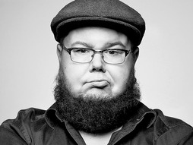
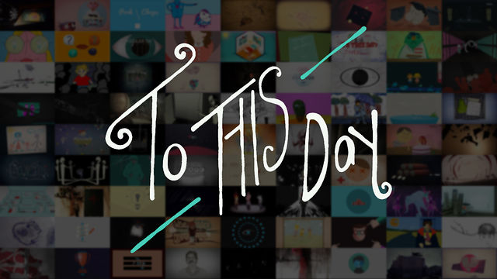
REVISIT
Go back through the poem, “To This Day” and label 3-4 literary devices you see…
Group share:
What literary device was your favorite and why?

Slide 21
YOUR TURN/REVISIONS
Go back through your “This I Believe” essay and make revisions…specifically by changing up the structure, adding in examples, and pushing more literary devices…

Slide 22
CLOSING
One thing I learned today was…

