Slide 1
TOURING…
Let’s go over what Auschwitz was and what it looked like…
Facts:
2000, and by 1944, 6000 people were being killed a day.
1.2-1.5 million people were killed, mostly Jewish victims.
It was built in June 1940, and liberated in Jan. 1945.
It was the largest camp.
Only 200,000 people survived.

Slide 2
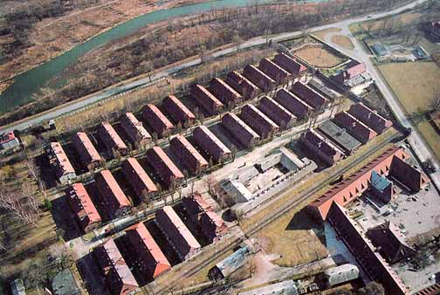
Auschwitz I

Slide 3
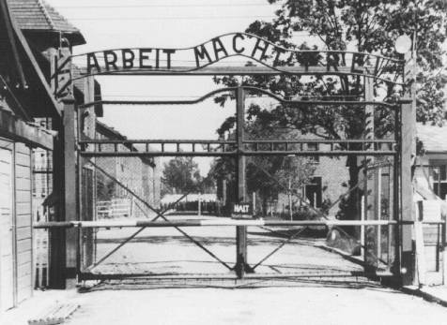
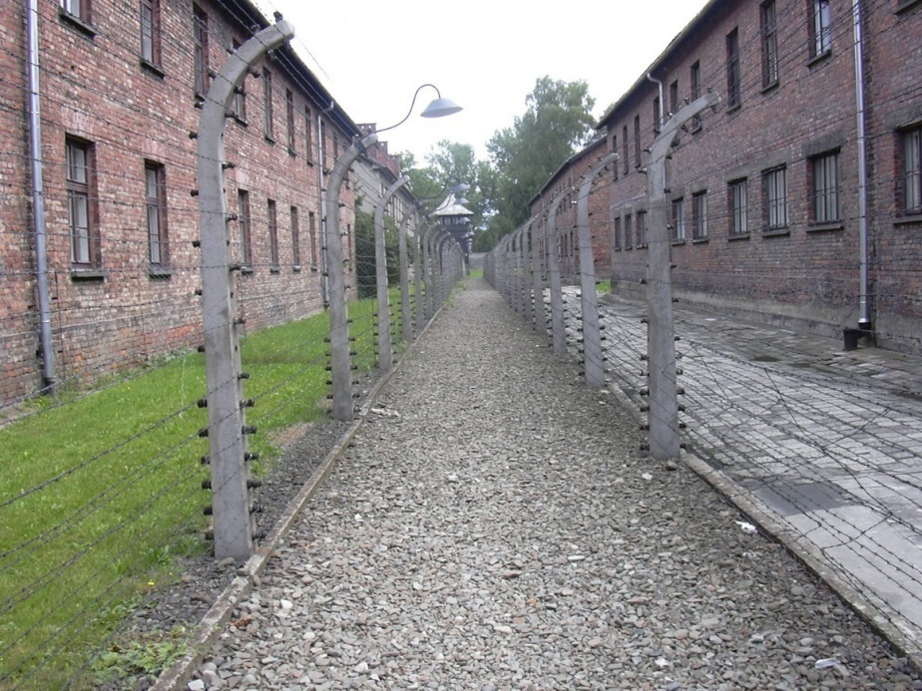
This is the infamous entrance and “work is liberty” sign.
Auschwitz I was the original camp, it became the administrative building with living quarters

Slide 4
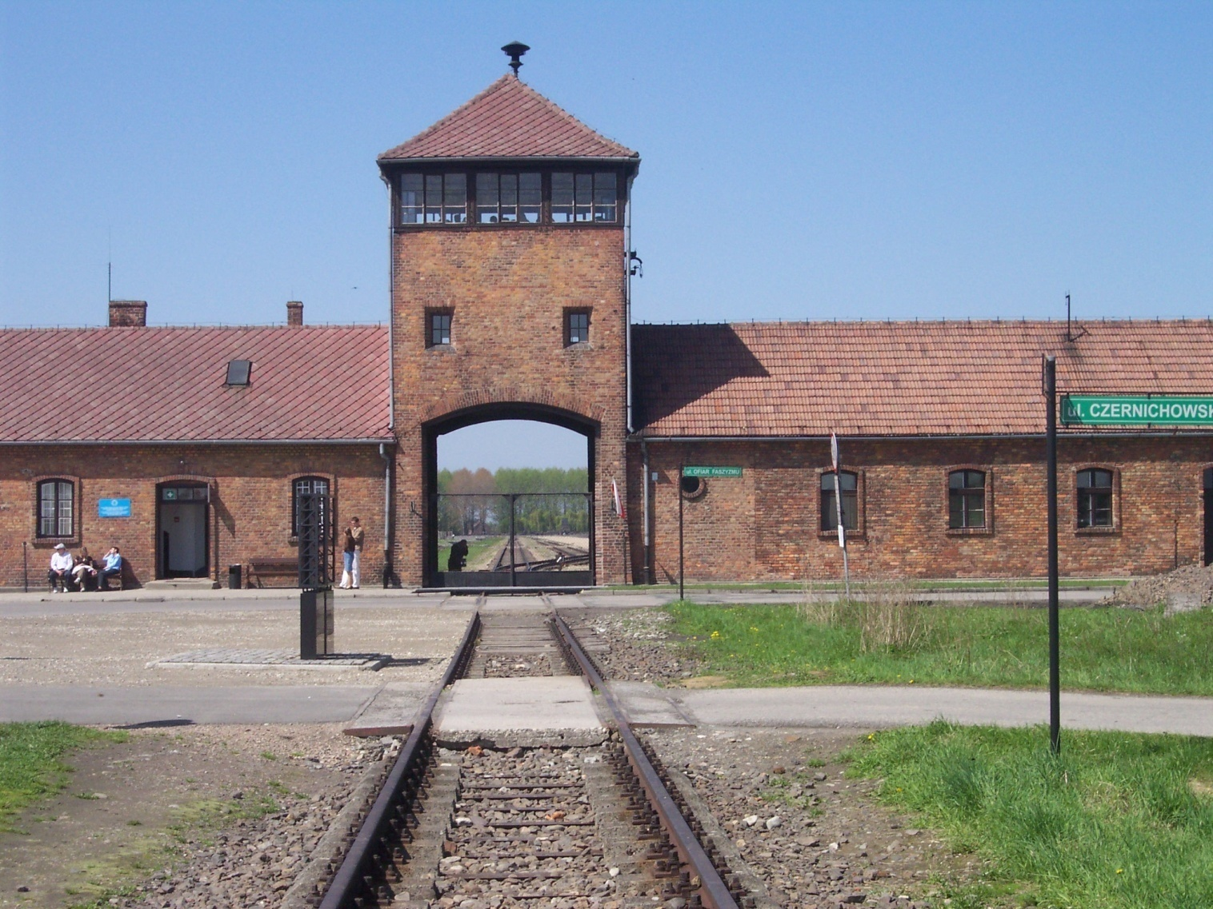
Auschwitz II-Birkenau Death Camp

Slide 5
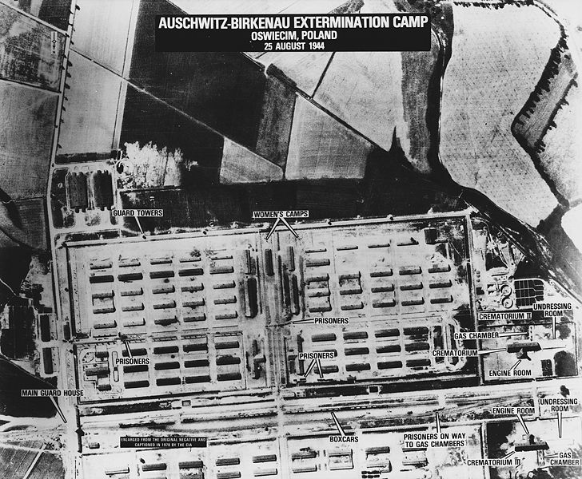
Auschwitz II-Birkenau was larger than Auschwitz I.
More than 1 million people passed through its gates than through Auschwitz.
This was the death camp.

Slide 6
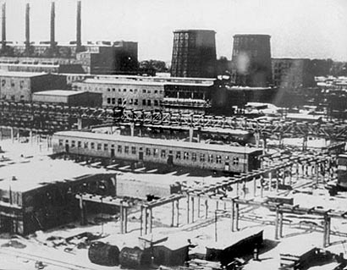
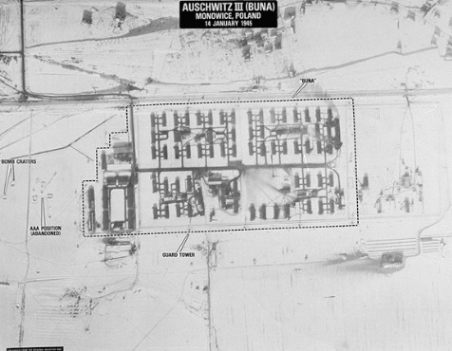
Auschwitz III-Monowitz or Buna

Slide 7
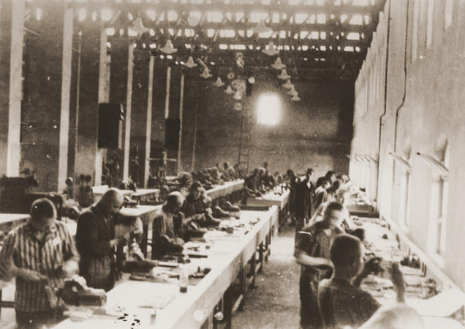
Auschwitz III was the work camp with factories.
This is where Elie spends a lot of his time.

