Slide 1
AGENDA
*Opening: Mentor Sentences
*Dashes Grammar: reading, rules, and write
*Write-time
*Closing: what did you learn about dashes?
*HW: Dash packet due Friday (if you didn’t finish it in class).

Slide 2
AGENDA
Dash Packet

Slide 3
OPENING ACTIVITY
Look at the three mentor sentences and do the chart on the first page of this packet…
What do you notice about the DASHES?
Can you imitate what you see?
What questions do you have?

Slide 4
ANNOUNCEMENTS
Homework: Today’s dash write-up will be due tomorrow (if you don’t finish it in class today).
Future Homework: The Annotated Bib. Final Draft is due Tuesday (you have some workshop time in class tomorrow).

Slide 5
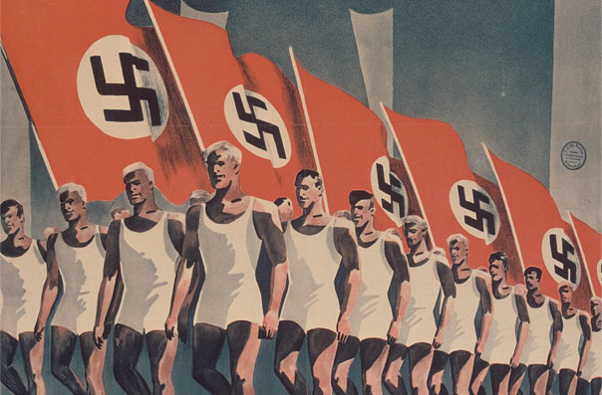
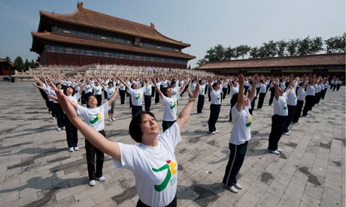
REAL WORLD PHYSICAL JERKS
http://www.youtube.com/watch?v=2H30-h1japQ

Slide 6
REAL WORLD PHSYICAL JERKS…
What are the physical jerks?
What is their purpose?
Germany and China used/uses mass exercise in their countries—article.
Discussion.

Slide 7
ARTICLE READ
Get with a partner and assign reading roles.
Read through the article and do a response at the end.
So…what do we think? Discussion…

Slide 8
INTERRUPTERS
What is wrong with the following sentences?
China one of the largest countries in Asia wants to mandate exercising.
Winston Smith our main character is forced to do exercises by the telescreen every morning.
Correct them!

Slide 9
GRAMMAR NOTES
Copy these upcoming notes on page 3 of your packet.
How do you make a dash on the computer?

Slide 10
THE DASH
What is the dash?
It usually sets off a thought or extra detail.
It can be used like a super comma…to set off an interrupter.
Example: Winston, a prisoner of his own world, starts to doubt BIG BROTHER.
Example: Winston—a prisoner of his own world—starts to doubt BIG BROTHER

Slide 11
THE DASH
It is used with…
An interrupting thought or idea.
And also at the end of the sentence—to draw a conclusion.
Example: Big Brother is a tool of fear and propaganda—he controls everyone.

Slide 12
THE DASH
It can NOT be used with an AAAWWWUBBIS phrase… (like a semi-colon)
When Winston steals the journal, he is afraid of the thought police.
When Winston steals the journal—he is afraid of the thought police. (NO GO!)

Slide 13
THE DASH
Now create your own sentence using a dash…
Governments shouldn’t create fear for their people—that is why Winston is so disgruntled with his life.
Now share it with someone NOT at your table!

Slide 14
THE DASH
Sample:
“On the coins, on stamps, on the covers of books, on banners, on posters, and on the wrappings of a cigarette packet—everywhere” (27).
This is a concluding dash.
Its effect is it really hits home the idea Big Brother is everywhere. It creates emphasis and helps clarify the main point of the sentence.

Slide 15
THE DASH
Now look through your book and find three sentences that use the dash.
Note the effect or purpose in the second box, you are stating the purpose specifically within that sentence or thought! Also, note what type of dash it is: interrupting or concluding.

Slide 16
THE DASH
Final Step!
Think back on the China Exercising Article, respond to the prompt and use two dashes.
Note Rubric!

Slide 17
CLOSING
What did you learn today?
Homework:
Turn this packet in by tomorrow for full credit.

